Slide 1
Project Progress Store Sales Time Series Forecasting
Mert Burabak

Slide 2
Agenda
1- Quick Review
2- Exploratory Data Analysis
3- Base Model: Linear Regression
4- MLP Model
5- LSTM Model
6- Results
7- Conclusion

Slide 3
Quick Review
Forecasting grocery store sales
Kaggle url: https://www.kaggle.com/c/store-sales-time-series-forecasting/overview
Goal of the Competition
«...you’ll use time-series forecasting to forecast store sales on data from Corporación Favorita, a large Ecuadorian-based grocery retailer.» (Competition Description)

Slide 4
Quick Review
There are 54 stores and 33 product families in the train data. The time series starts from 2013-01-01 and finishes in 2017-08-31. The dates in the test data are for the 15 days after the last date in the training data.
There are 6 different data source for the retailer:
Train
Test
Store
Transactions
Holidays and Events
Daily Oil Price

Slide 5
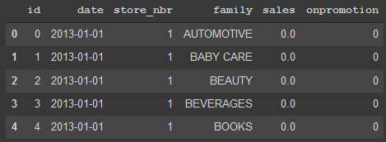
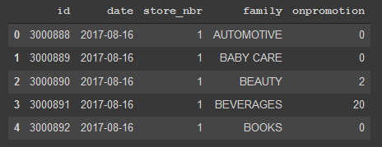
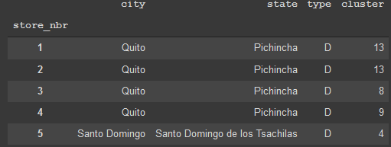
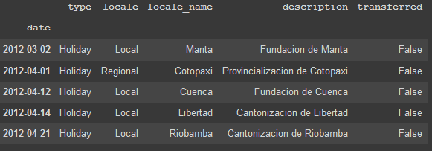
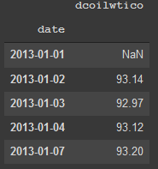
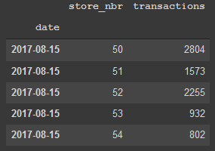
EDA
Train
Test
Holidays
Stores
Oil
Transactions

Slide 6
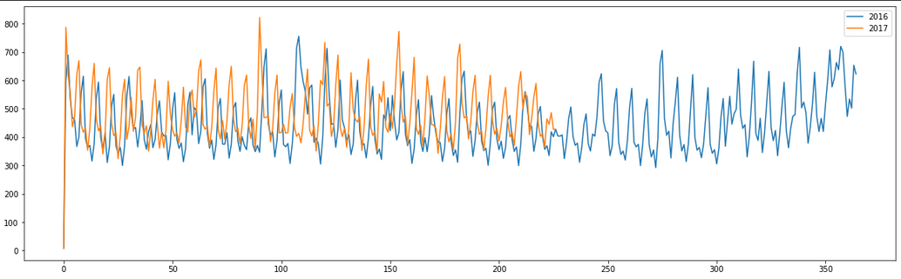
EDA
Avg.Sales Distribution

Slide 7
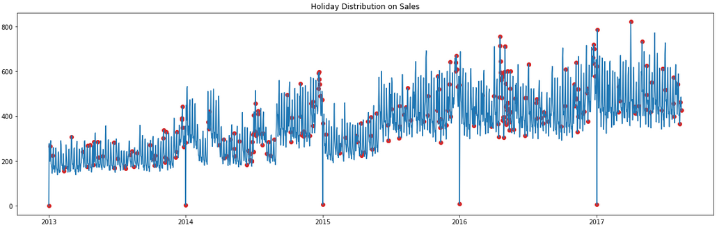
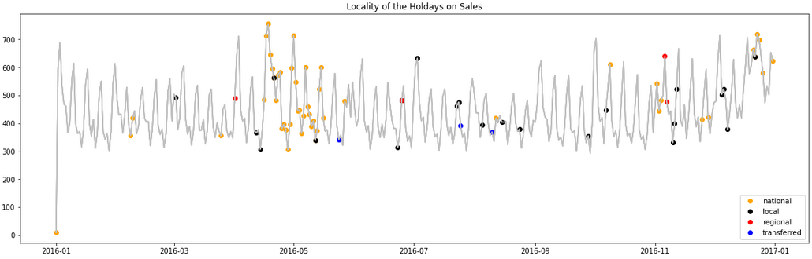
EDA

Slide 8
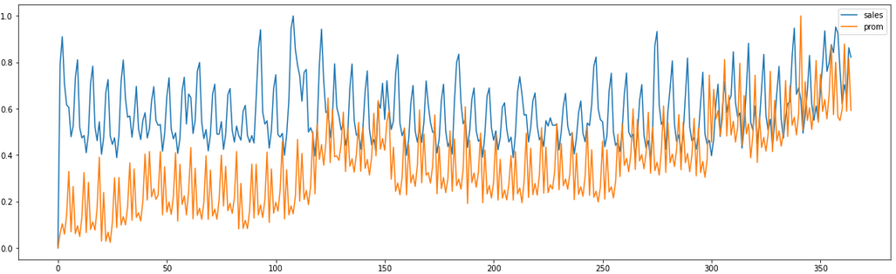
EDA
Promotions and Sales (MinMaxScaled)

Slide 9
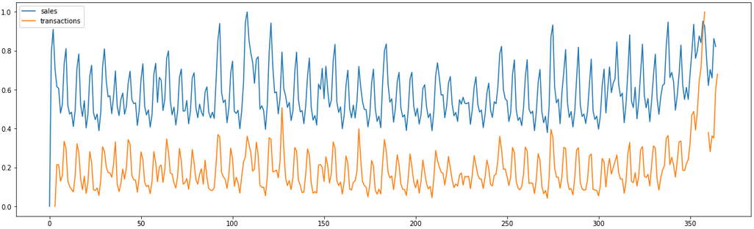
EDA
Transactions and Sales (MinMaxScaled)

Slide 10
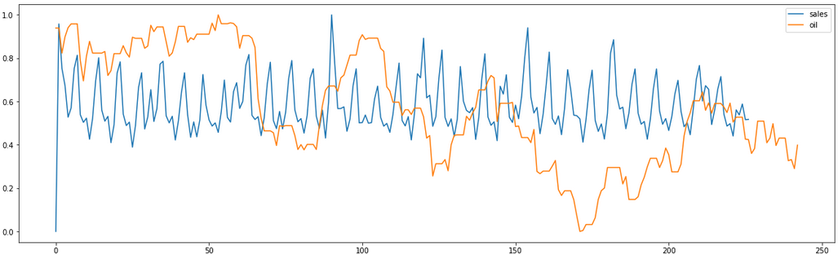
EDA
Oil and Sales (MinMaxScaled)

Slide 11
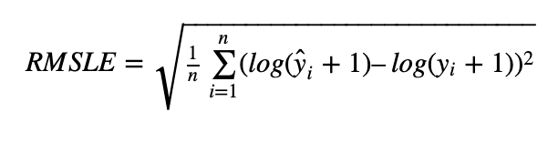
Solution
Model: a time-series model that more accurately predicts the unit sales for thousands of items sold at different stores.
Model target: from the time t, forecasting the store demand for t+15 days
Evaluation Metric: Root Mean Squared Logarithmic Error(RMSLE)
Expectation: good performance(RMSLE <= 0.6), perfect understanding of trend and seasonality compenents

Slide 12
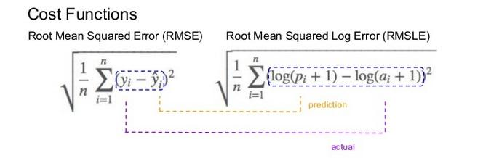
Base Model: Linear Regression
Time Series Split(5-fold)
DATA: [0 1 2 3 4 5]
TRAIN: [0] TEST: [1]
TRAIN: [0 1] TEST: [2]
TRAIN: [0 1 2] TEST: [3]
TRAIN: [0 1 2 3] TEST: [4]
TRAIN: [0 1 2 3 4] TEST: [5]
Train-test split method: Rule-based
Train set: 2017-01-01 – 2017-08-31
Test set: 2018-18-16 – 2017-08-31
Cross Validation Method: 5-fold Time Series Split
Evaluation Metric: Mean Absolute Error, Root Mean Squared Logarithmic Error
Algorithm:
1.For fold in K-fold:
- Train without data[fold]
- Predict Test Set
1.1:Post-processing: if prediction <0 then 0 else prediction end
2.Calculate mean of prediction
3.Evaluate result
4

Slide 13
Baseline Model: Linear Regression Results
Only Date Features (dayofweek, weekofyear, quarter, month, dayofyear)
Date Features + Dummies for dayofweek
Date Features + Dummies + new_year(bool)
Date Features + Dummies + new_year + pay_days(bool)
Date Features + Dummies + new_year + pay_days + holidays
Date Features + Dummies + new_year + pay_days + holidays + Oil
mae = 60.951 rmsle = 0.156
mae = 39.877 rmsle = 0.112
mae = 39.877 rmsle = 0.112
mae = 40.124 rmsle = 0.111
mae = 40.496 rmsle = 0.110
mae = 42.871 rmsle = 0.113

Slide 14

Baseline Model: Linear Regression Kaggle Results
Kaggle Submission Result with Linear Regression:
rmsle = 0.47537
Rank: 155 / 892 (%17)
Initial Goal: rmsle <= 0.6
Next Goal: better results with Deep Learning Methods (LSTM)

Slide 15
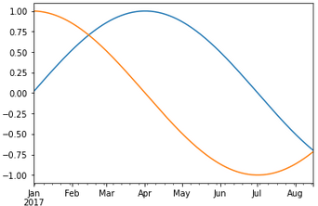
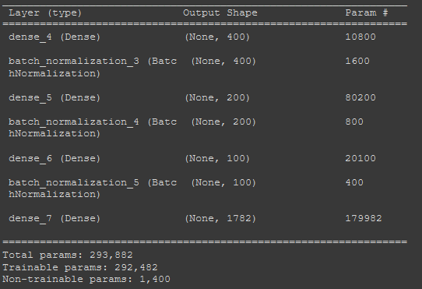

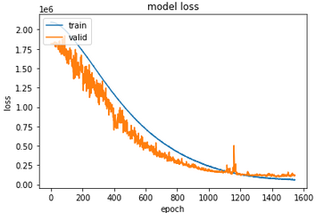
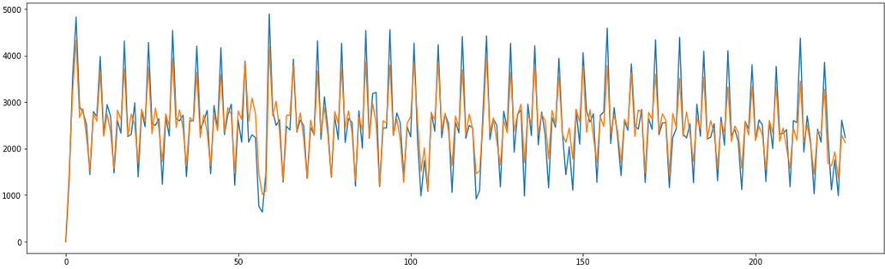
MLP Model
sin,cos
New features: cyclic dayofyear, month features(%13 improvement)
İnput
Output
(EarlyStopping(patiance=100), Epochs=5000):
After optimising hyperparameters and architecture
Optimal structure:
Loss: ‘mse’
Optimizer: Adam
Learning rate: 0.001
Batch Size: 32

Slide 16
MLP Model Results
rmsle: 0.161
Kaggle Results: 0.58688 (previous: 0.47537)
What is next?
More input(just 2017 used at the traning&validation dataset)
Scale input&output(then inverse_scale)
Different model architecture(LSTM Layers)

Slide 17
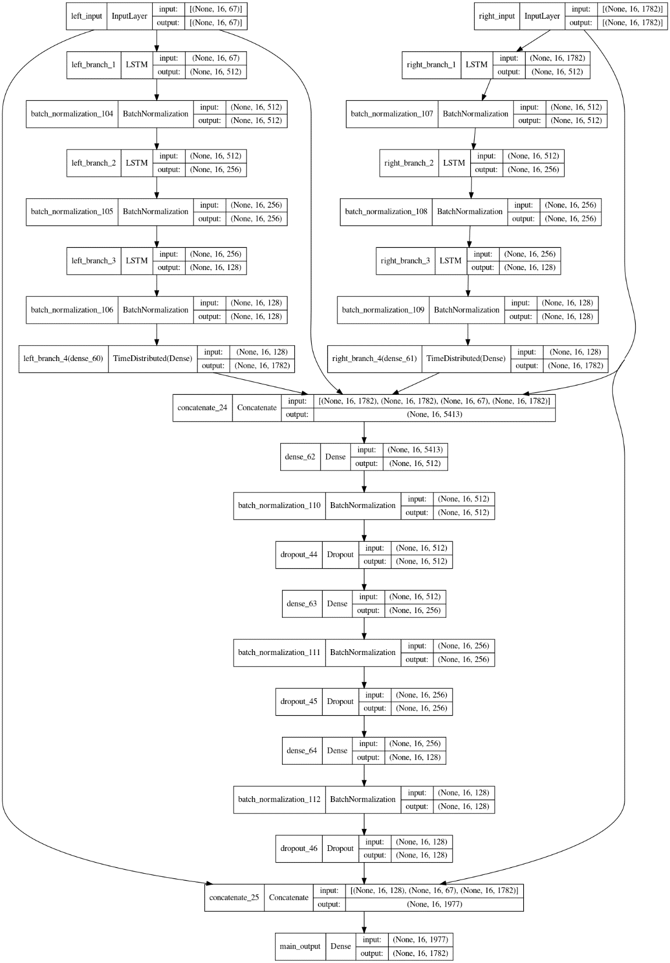
LSTM Model
Tabular data -> sequential data
(input: last 16 days -> output: next 16 days)
5-CV
Model:
Left Branch: datetime features -> target
Right Branch: old values -> new values
LSTM Layer Block: 512->256->128
Dense Layer Block: 512->256->128 (Dropout: 0.1)
Epochs: 2000, batch_size: 64, lr: 0.05(adam)
Callbacks: {EarlyStopping, ReduceLRonPlateau}

Slide 18
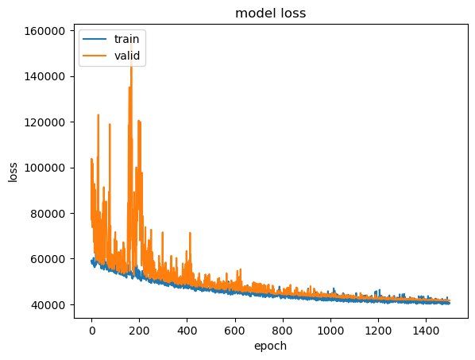
LSTM Model Results
mae:41.859, rmsle: 0.107
Kaggle Results: 0.46310 (%3 improvement)
Last 1500 epoch (mse)

Slide 19
Final Kaggle LB Results
Linear Regression:
rmsle = 0.47537
MLP:
rmsle = 0.58688
LSTM:
rmsle = 0.46310

